Slide 1
Online Fraud Detection

Slide 2
Team Members Name
Shubham Kushwaha
(ML Developer )
Somesh Yadav
(web Developer )
Mentored By
Mr. Ashutosh Mishra
Mohd. Yasir
(Frontend )
Yuvraj Singh Yadav
(Frontend )

Slide 3
1
Table of Contents
2
3
4
Problem Statement
Purpose of Project
Objective & Scope
Feasibility Study
Methodology
5
Requirement Analysis
6

Slide 4
01
Problem Statement

Slide 5
Problem
Online transactions and digital interactions face growing threats like credit card fraud and identity theft, putting businesses and users at risk of financial losses and compromised data. To safeguard against these risks, an efficient fraud detection system is crucial, as it can swiftly detect and prevent fraudulent activities, ensuring the security of online transactions and platforms

Slide 6
Purpose of Project
1.
2.
Security Enhancement
Real Time Detection
3.
4.
Fraud Loss Protection
User Trust & Confidence

Slide 7
Objective & Scope
Develop Accurate Fraud detection Model
Reduce false Positives
Continuous Improvement
Feedback and Reporting
Geographical Coverage
Industries and Sectors

Slide 8
Feasibility Study
Financial Feasibility
Technical Feasibility
Legal and Regulatory Feasibility
Market Feasibility

Slide 9
Methodology
Model Training
Data Processing
Model Deployment
Data Collection
Testing and Validation

Slide 10
Requirement Analysis
Exploratory Data Analysis(EDA)
Python || HTML CSS
Machine Learning Techniques

Slide 11
Our Progress
Requirement Analysis
Design
Testing
1
2
3
4
5
6
Project Planning
Coding & Implementation
Deployment &
Maintenance

Slide 12

Homepage View

Slide 13

Login Page

Slide 14
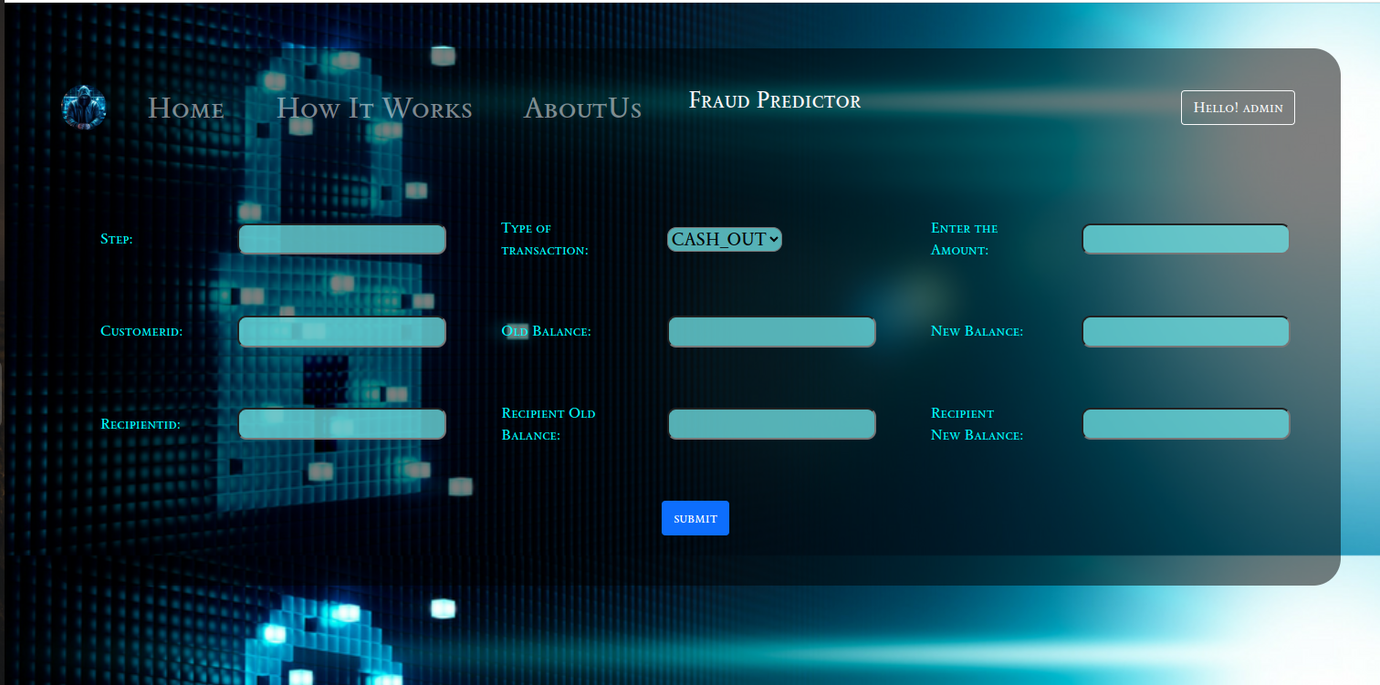
Fraud Predictor Page

Slide 15
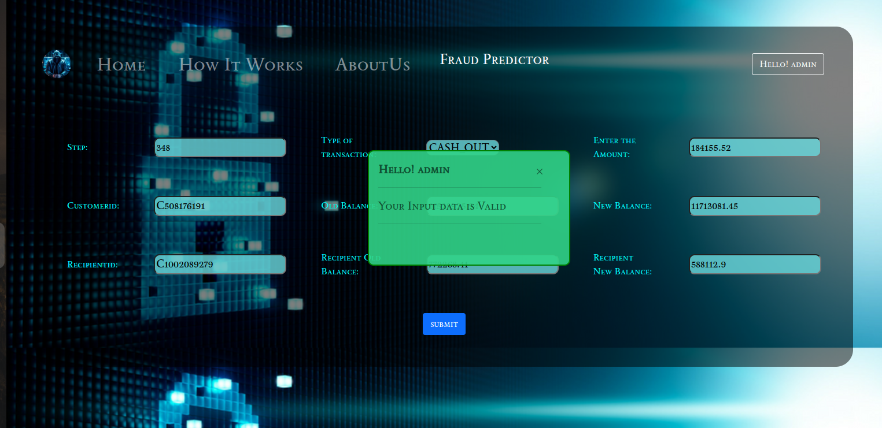
Sample Fraud prediction Output

Slide 16
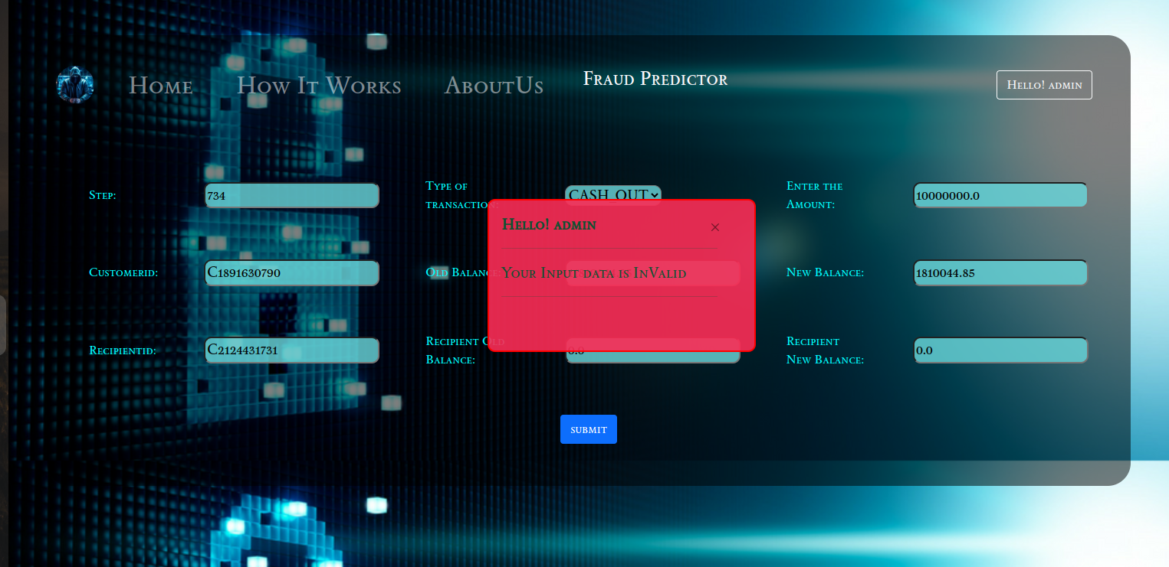
Sample Fraud Prediction output

Slide 17
Thanks!

